Slide 1

Your Notes
Speech to Text Annotation App
Son Chau, Yinghsuan Lo, Nikhil Gaur, Annie Liu

Slide 2
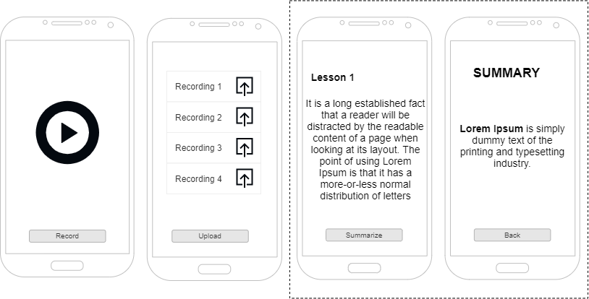
Our Goal:

Slide 3
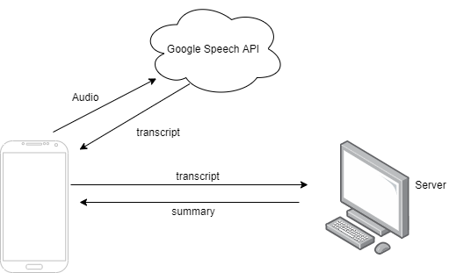
Our Model

Slide 4
Overview
Speech Recognition:
Call Google Speech API
Text summarization:
Text processing
Using part of yelp academic review dataset as our temporary dataset
using TextRank, PageRank algorithm along with word embedding GloVe Word

Slide 5
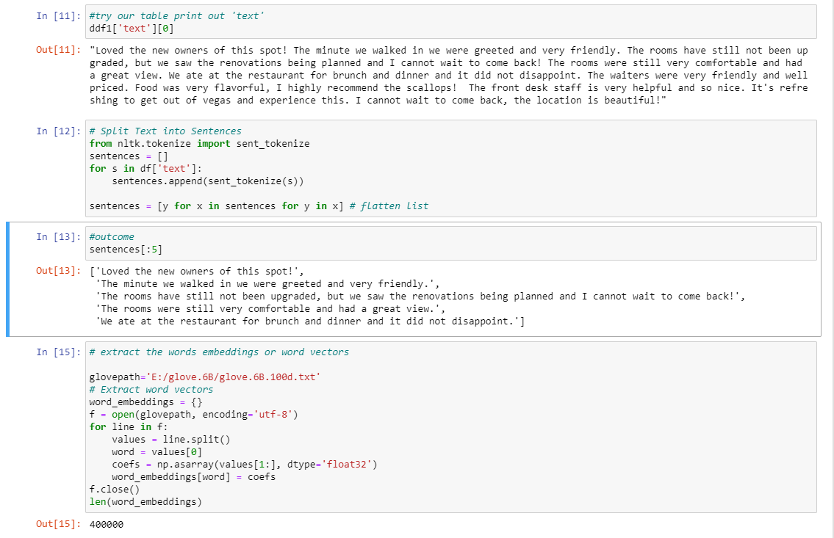
Text processing:

Slide 6
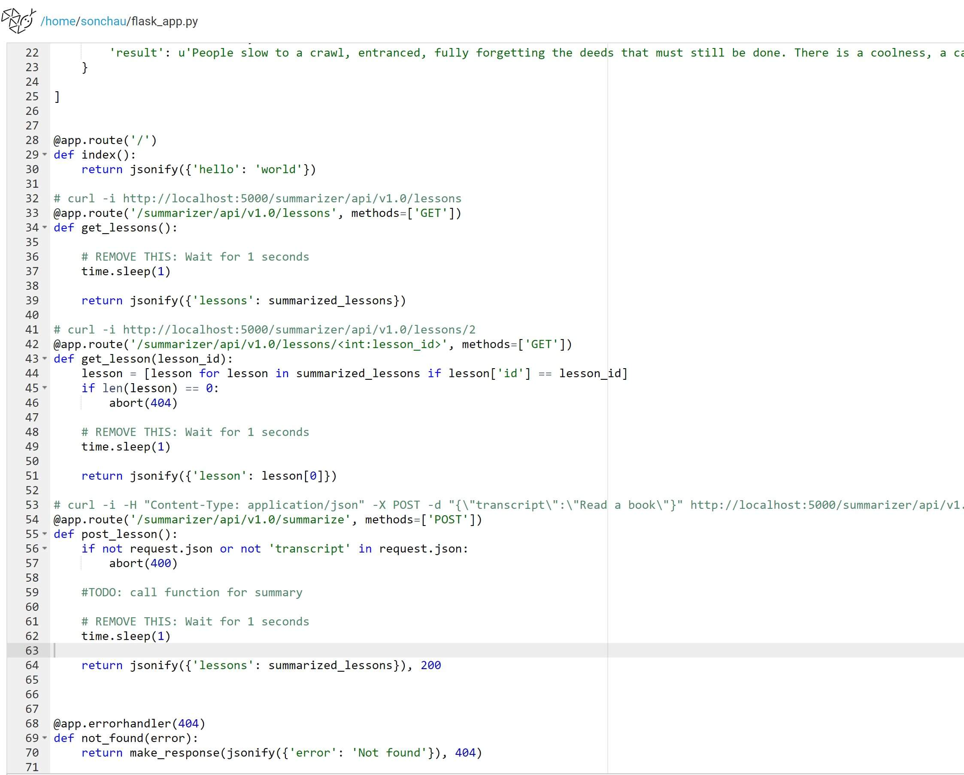
Server
-Endpoint API and run python codes
-Host on PythonAnywhere
-Basic POST and GET method

Slide 7
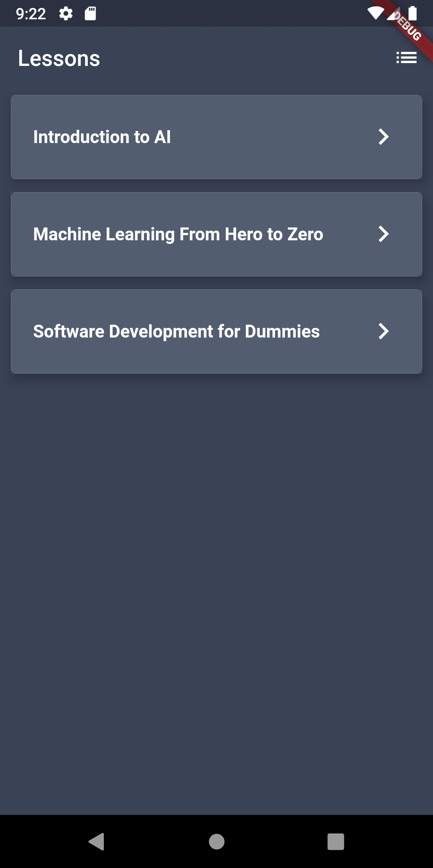
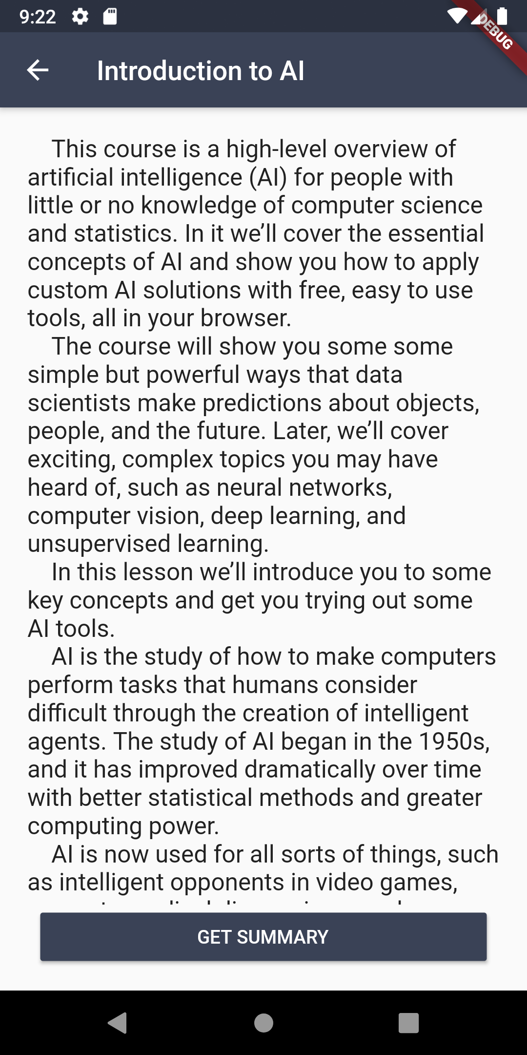
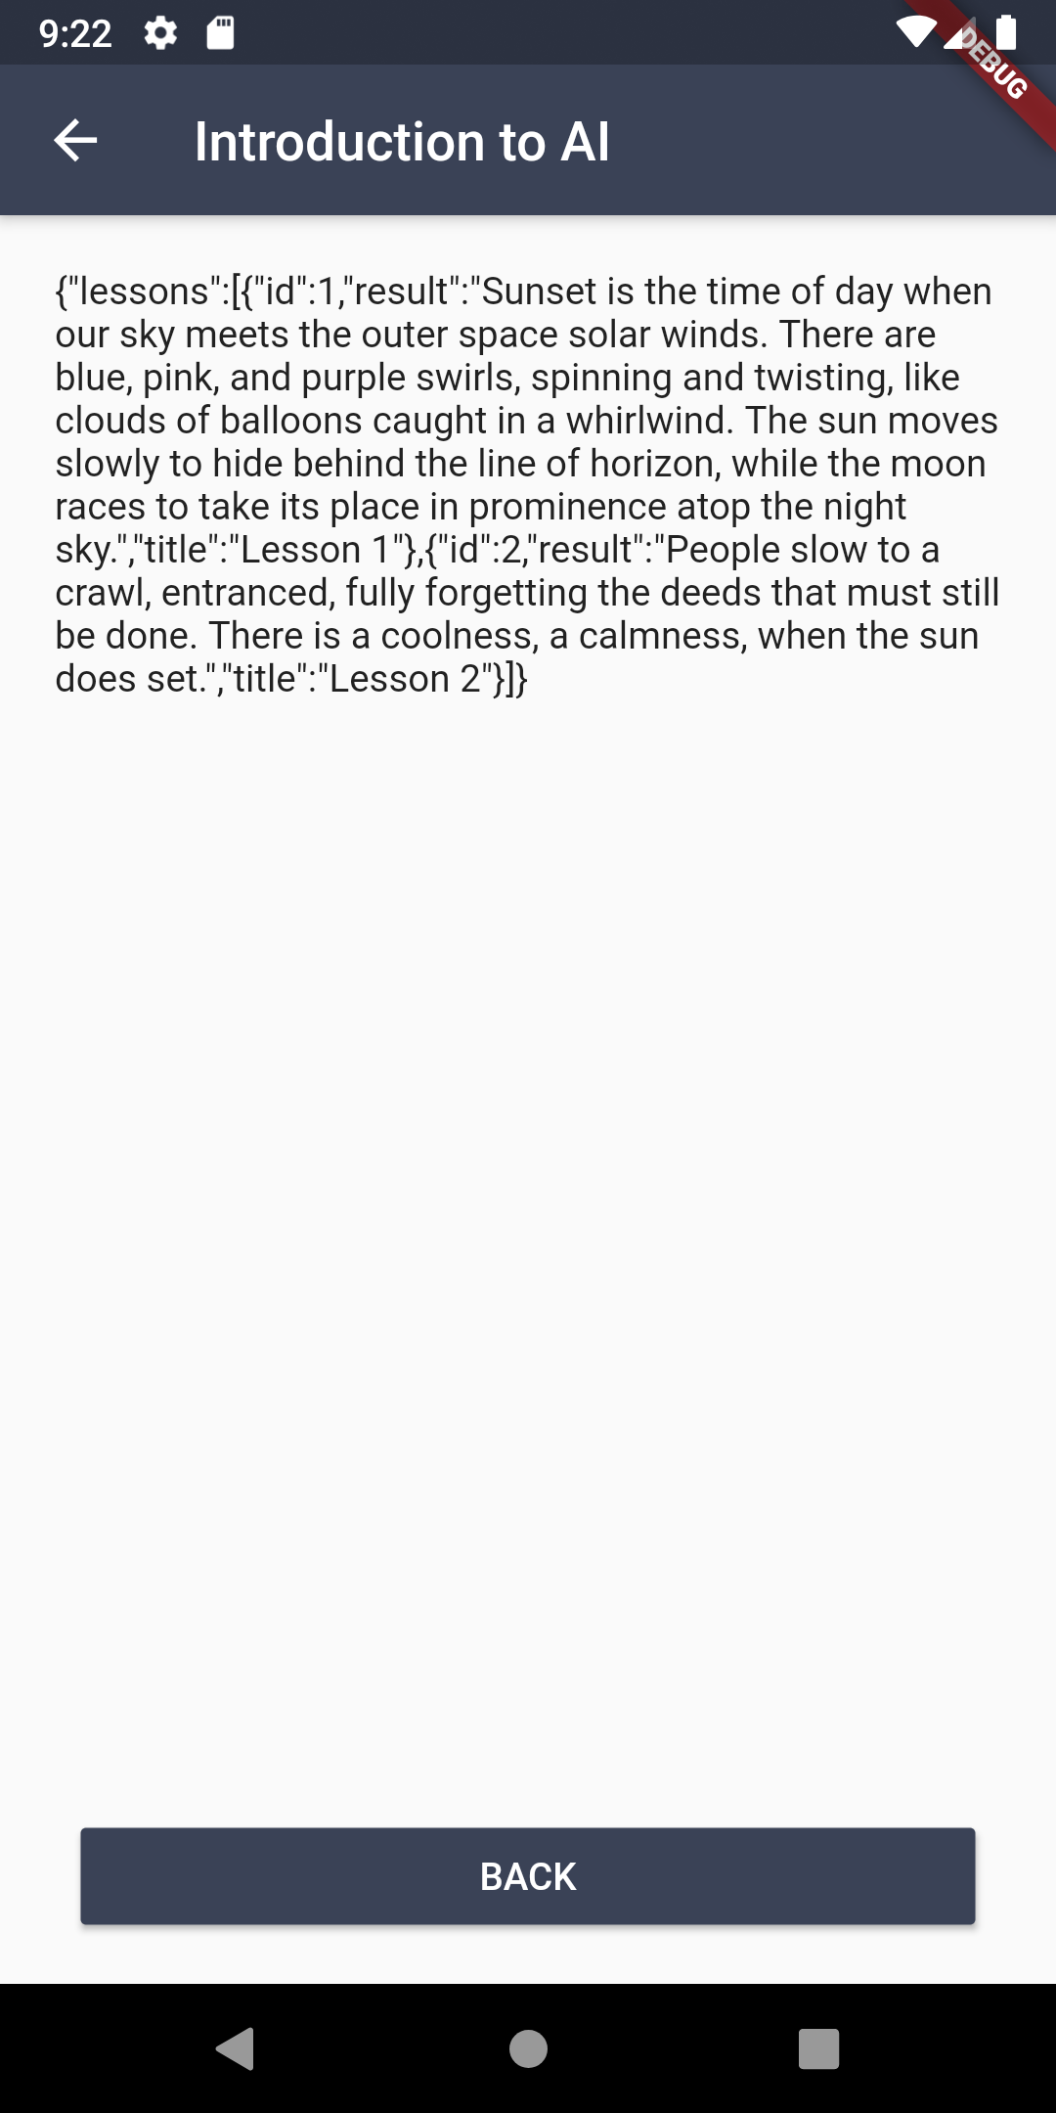
App
-Selection page
- Full Transcript
- Summary
-Send and receive data from the server via API

Slide 8
Challenge
-Phone doesn’t support long speech to text.
-Google Speech is not free
-Some constraints working on mobile
-Free server has limited resources
-Summarization is hard

Slide 9
Next
-Implement extractive method on the server
-Evaluate the summary (optimize or try other methods)
-Audio recording (require real device)
-Use Google Speech API for transcript

Slide 10
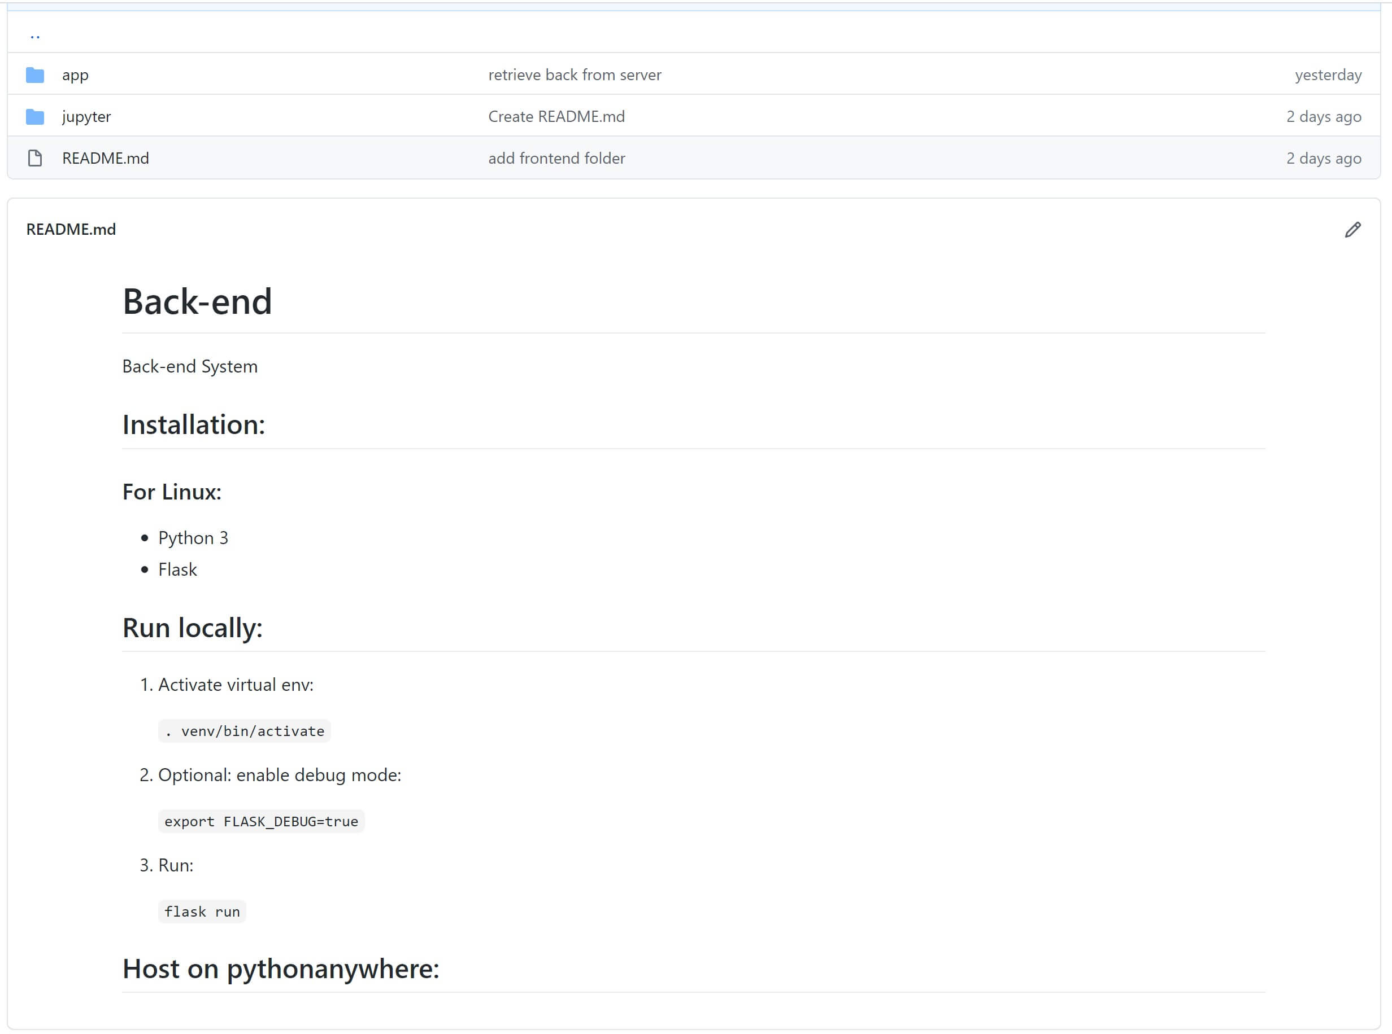
Github Repository
https://github.com/LoriSchuan-dev/SoftAIP2_YourNote

